Slide 1
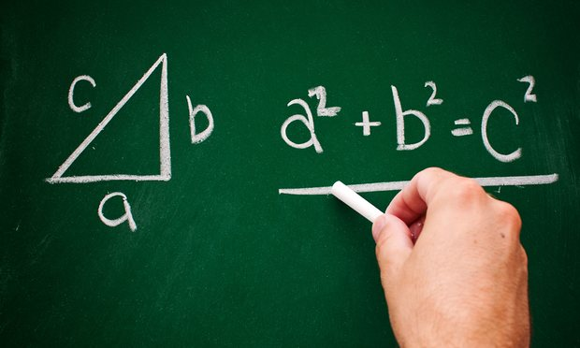
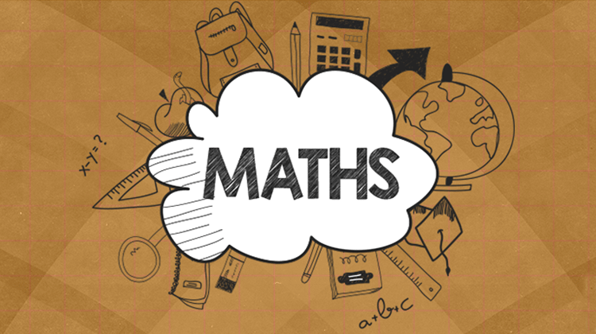
MathS Algebra– Equations
Aims:
To understand the concept of an equation.
To examine if a number makes an equation true.
To solve one-step equations using the definition of mathematical operations:
a+x=b, a-x=b, x-a=b, a•x=b, a:x=b, x:a=b
To apply 1st degree equations on real-life problems.
2^{ο} Gymnasium Eletheriou Venizelou

Slide 2
Convert the following expressions using mathematical expressions with numbers and symbols: (Edmodo Quiz 1)
The next number of a natural number:
The previous number of a natural number:
Multiply a number by two
Half of a number:
If we add five to a number equals eight:
Equation with one unknown is an equality with
numbers and a symbol (called unknown).
n+1
n-1
2•x
x:2
x+5=8

Slide 3
Edmodo Quiz 2
(α) Examine if the number 2 makes the equation true: 2x-4=6
(β) Examine if the number 5 makes the equation true:: 3x-4=11
(γ) Examine if the number 1 makes the equation true:: 4,5*x+2,5=7
♥ 2*2-4=0 (false)
♥ 3*5-4=11 (true)
♥ 4,5*1+2,5=7 (true)
Solution or root of an equation is a number which makes the equation true if it substitutes the symbol. .

Slide 4
Solving the following equations:
a)x+2=5 d) 2x = 12
b)x-2=5 ε) x/2 =12
c)7-x=5 στ) 10/x=5
The symbol x is called the unknown of the equation.
<=> x=5-2
<=> x=3
<=> x=12:2
<=> x=6
The proceduce of finding the solution to the equation is called solving the equation.
<=> x=5+2
<=> x=7
<=> x=12*2
<=> x=24
<=> x=7-5
<=> x=2
<=> x=10:5
<=> x=2

Slide 5
Problem based on 1st degree equation
(Edmodo Quiz 3)
There are 38 boys. This is 6 more than double the number of girls.
Solution
Let x be the number of girls. Then:
2x+6=38 <=> 2x=38-6 <=> 2x=32 <=> x=32:2
<=> x=16 girls

Slide 6
Problem based on 1st order equations
(Edmodo Quiz 3)
Turkey has 67.800.000 more citizens than Greece, Italy 48.900.000, Romania 8.000.000 while Slovenia has 9.700.000 fewer citizens. If in total they have 173.500.000 how many citizens does each country has?
Solution
Let x be the population of Greece. Then:
x+67.800.000+x+48.900.000+x+8.000.000+x-9.700.000=173.500.000
x+x+x+67.800.000+48.900.000+8.000.000-9.700.000=173.500.000
<=>3x+35.100.000
<=>x=35.100.000:3
<=> x=11.700.000 citizens
Then, Greece= 11.700.000 Turkey= 79.500.000
Italy= 60.600.000 Slovenia= 2.000.000
Romania=19.700.000

Slide 7
Let's play..The fastest wins...
Kahoot.it
However, everyone will have learnt to solve equations...
Good luck!

