Slide 1
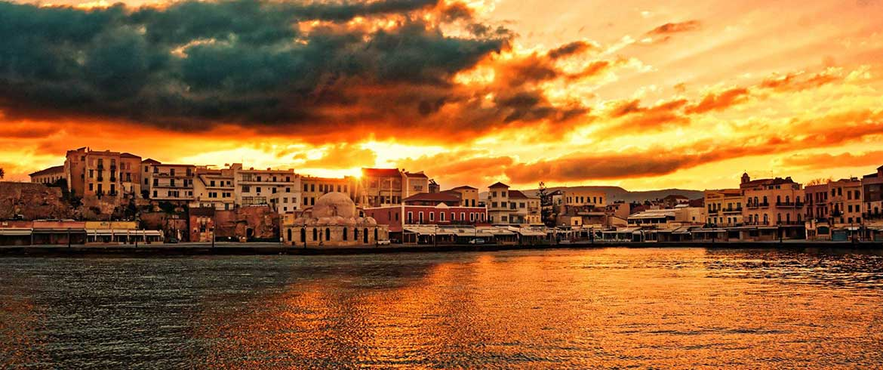
Chania
2o gymnasio Eleftheriou Venizelou

Slide 2
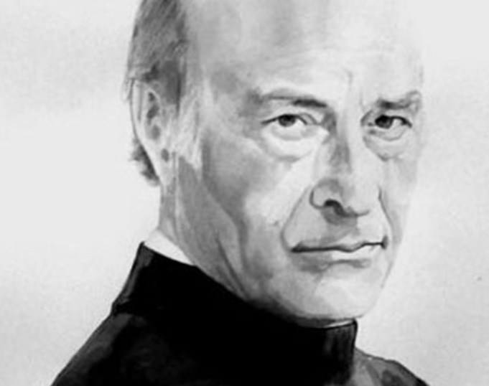
Odysseus
Elytis
Welcome to our lesson !!!

Slide 3
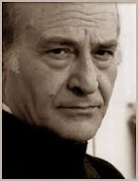
Let’s do a little
Odysseus Elytis
www. Biography

Slide 4
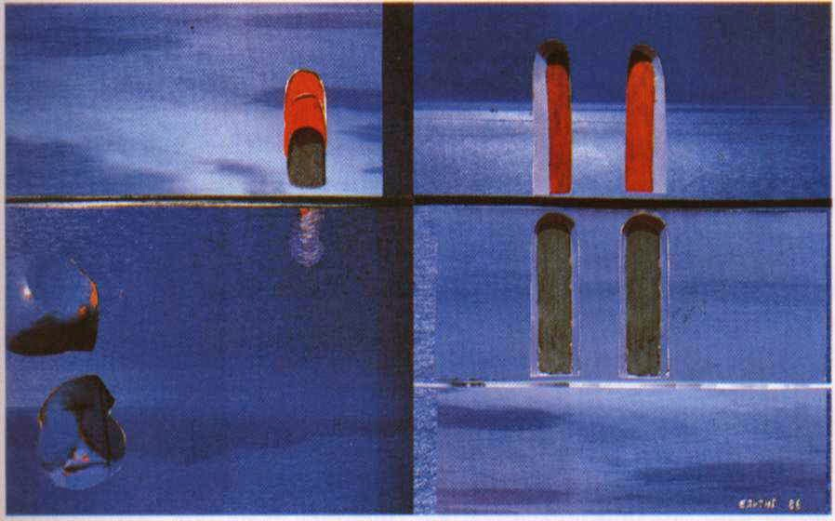
Crossword

Slide 5
collage pictures and paintings
www.Elytis'-Collages

Slide 6
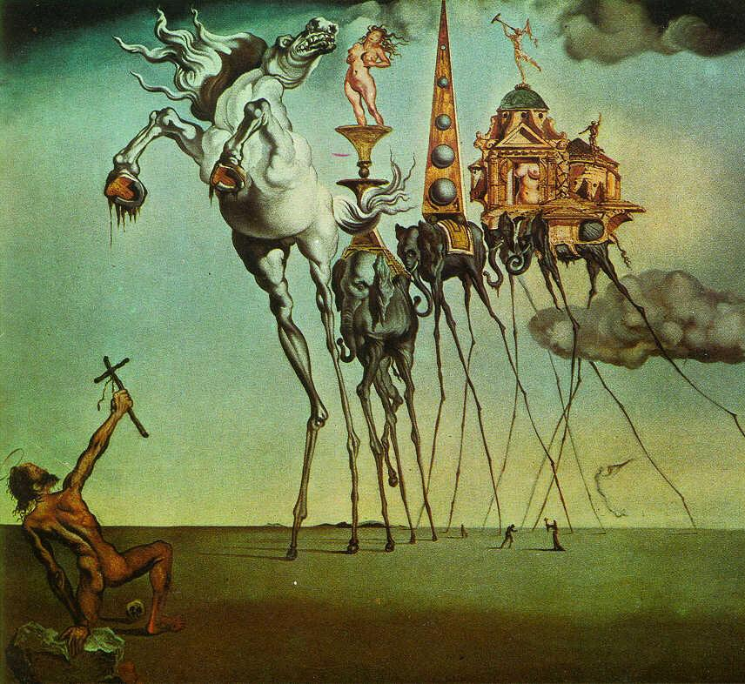
Is that for real ?
Surrealism !!!

Slide 7
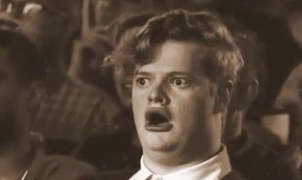
First
Let’s do a little
Then
watch this video !!!
Reading
www. Biography
www.explore-what-is-surrealism

Slide 8
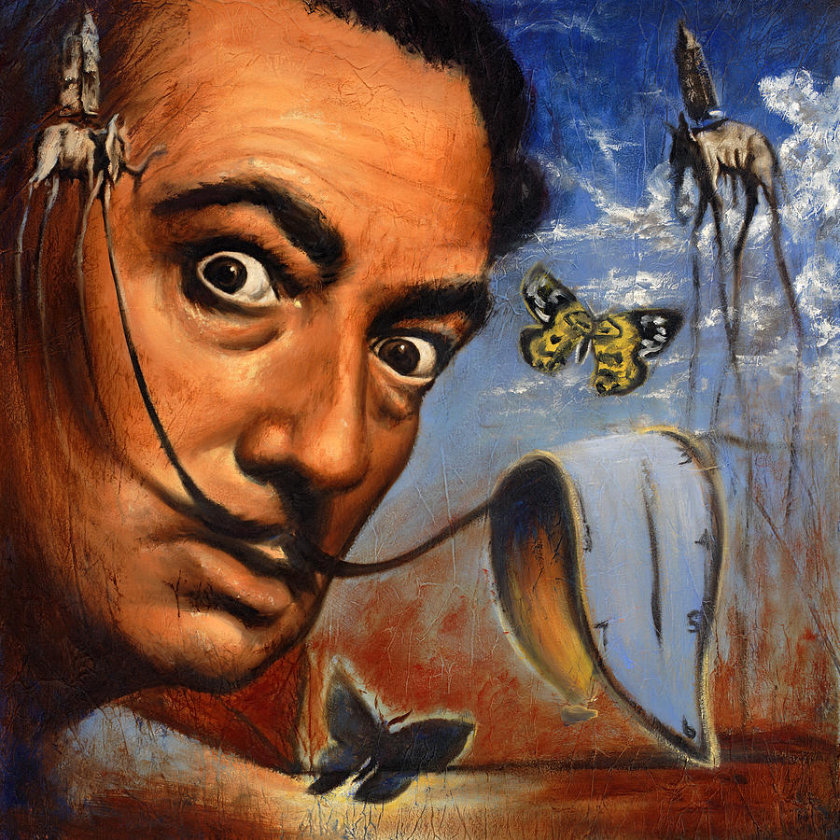
Let’s play kahoot !!!
Be the next surrealist Master of the Universe !!!

Slide 9
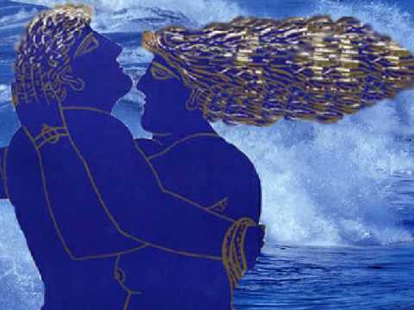
The summer took it all
By Odysseus Elytis

Slide 10
Let’s do a little
Listen to the song
Reading
www.youtube.
www. Poem Odysseus Elytis.

Slide 11
www.wordle.net
Make your own wordcloud
Choose from Elytis’ poem words or phrases you like the most

Slide 12
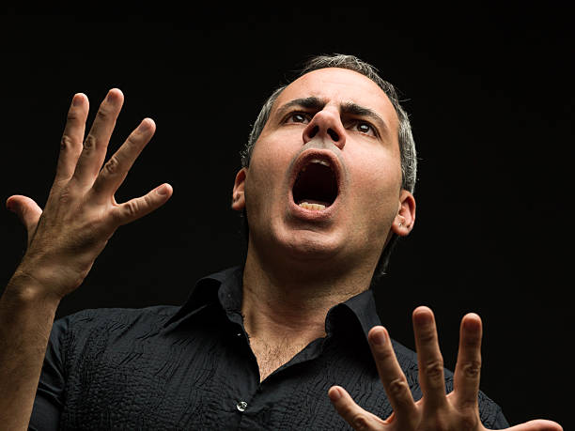
Let’s all play
kahoot!!!
2ogymnelbeniz
Nik52547

Slide 13
Now it’s your turn….!
Write your own poem
about Summer
5 to 10 verses …!
… you can
also find a picture you like and put it together !

