Slide 1
2nd Gymnasio Eleftheriou Venizelou Chania - Greece
Name of Digital Lesson
“The Christian faith of Catacombs”

Slide 2
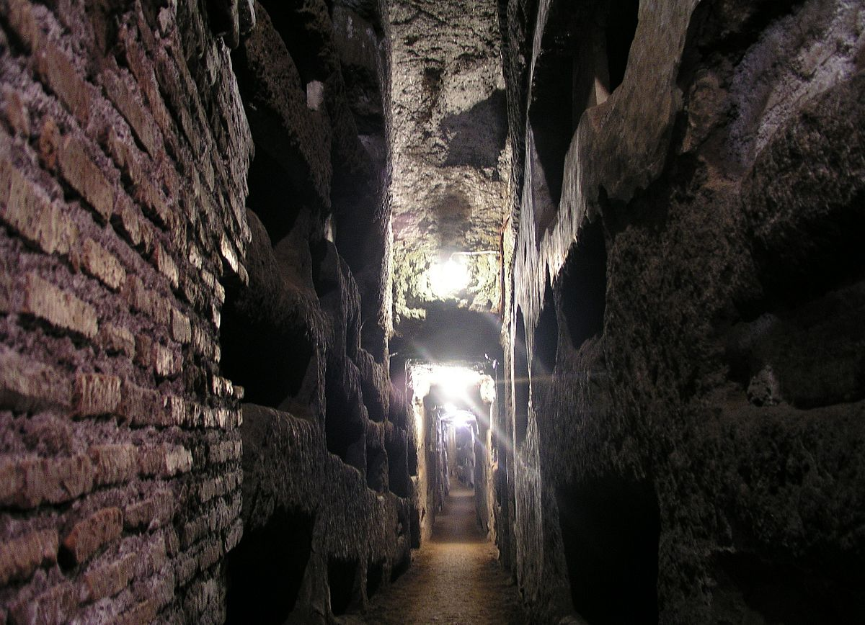
The Catacombs

Slide 3
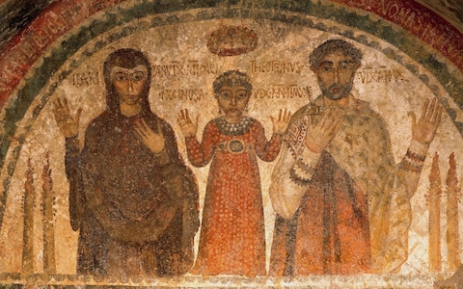
Inside the Catacombs
The catacombs were tombs where Christians burying their relatives. Christian members or a whole family could have their own family tomb. The catacombs were important for Christians and their lives until the Edict of Milan which is known as the Edict of religious toleration (313 A.D.).

Slide 4
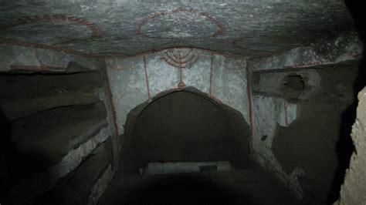
Catacombs as a cemetery
During the roman period all the people were buried outside the walls of the city for medical reasons but the Christians weren’t permitted to be buried also in public cemeteries because of their reference to Christ. Romans at that time were not Christians and they had adopted a religious system with a great number of Gods. Thus Christians made the Catacombs to bury their people and they did it at first in the private land of rich members of the church

Slide 5
Evolution of the Catacombs
From century to century the Christians became more and more. That fact had consequences. A high demand for burying people inside the Catacombs ; and secondly the evolution of the Catacombs. So later, catacombs cover many kilometers and tend to become a place of worship and small churches, as there were buried the Christians who had be killed for refusing joining the roman religion. Those buried members of the church were became martyrs and saints for the Christians who started preparing the Mass (Office) upon the tomb. Consequently the Catacombs from cemetery turn rapidly out to be considered as a small church and artists start painting on the walls symbols of their Christian faith and later figures that they respect as members of the church.

Slide 6
Artistic creation inside Catacombs

Slide 7
Architectural characteristics
Catacombs were subterranean and looked like tunnels of many kilometers. There were tombs in the alcoves (recess) of the walls and that spot became a tomb and later a church. On the wall the artists were painting their faith in God. Churches were like that during the first centuries of Christianism
A family tomb that has become Church

Slide 8
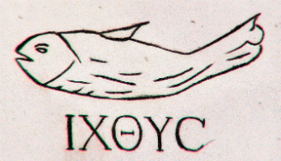
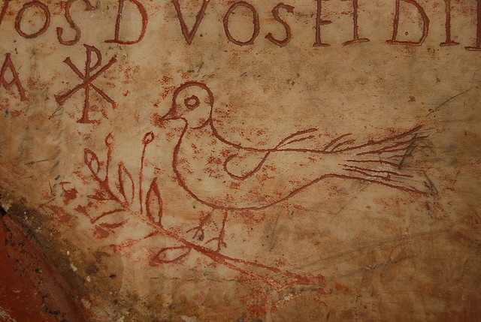
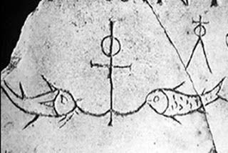
First Christian symbols
The first artists of Christianity delivered us great samples of their creativity. Most of their paintings are symbols.
Doves, olive branches, certain letters of the Greek alphabet with a hidden meaning, as the first and the last – Α alpha and Ω omega or Χ chi and Ρ ro.
The question is why the majority of the paintings of the first Christian artists are symbols ? (activity for the students, writing text)

Slide 9
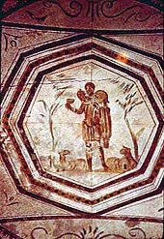
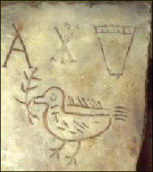
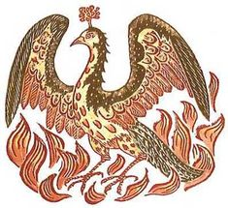
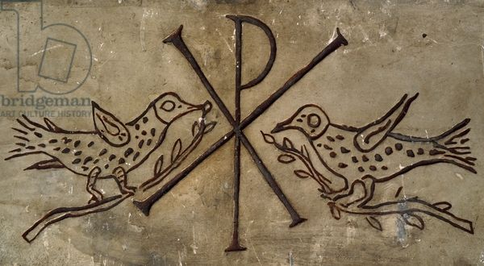

Slide 10
Choose and paint 10 minutes activity

Slide 11
MODERN CLASSROOMS MODERN EDUCATION

